Slide 1
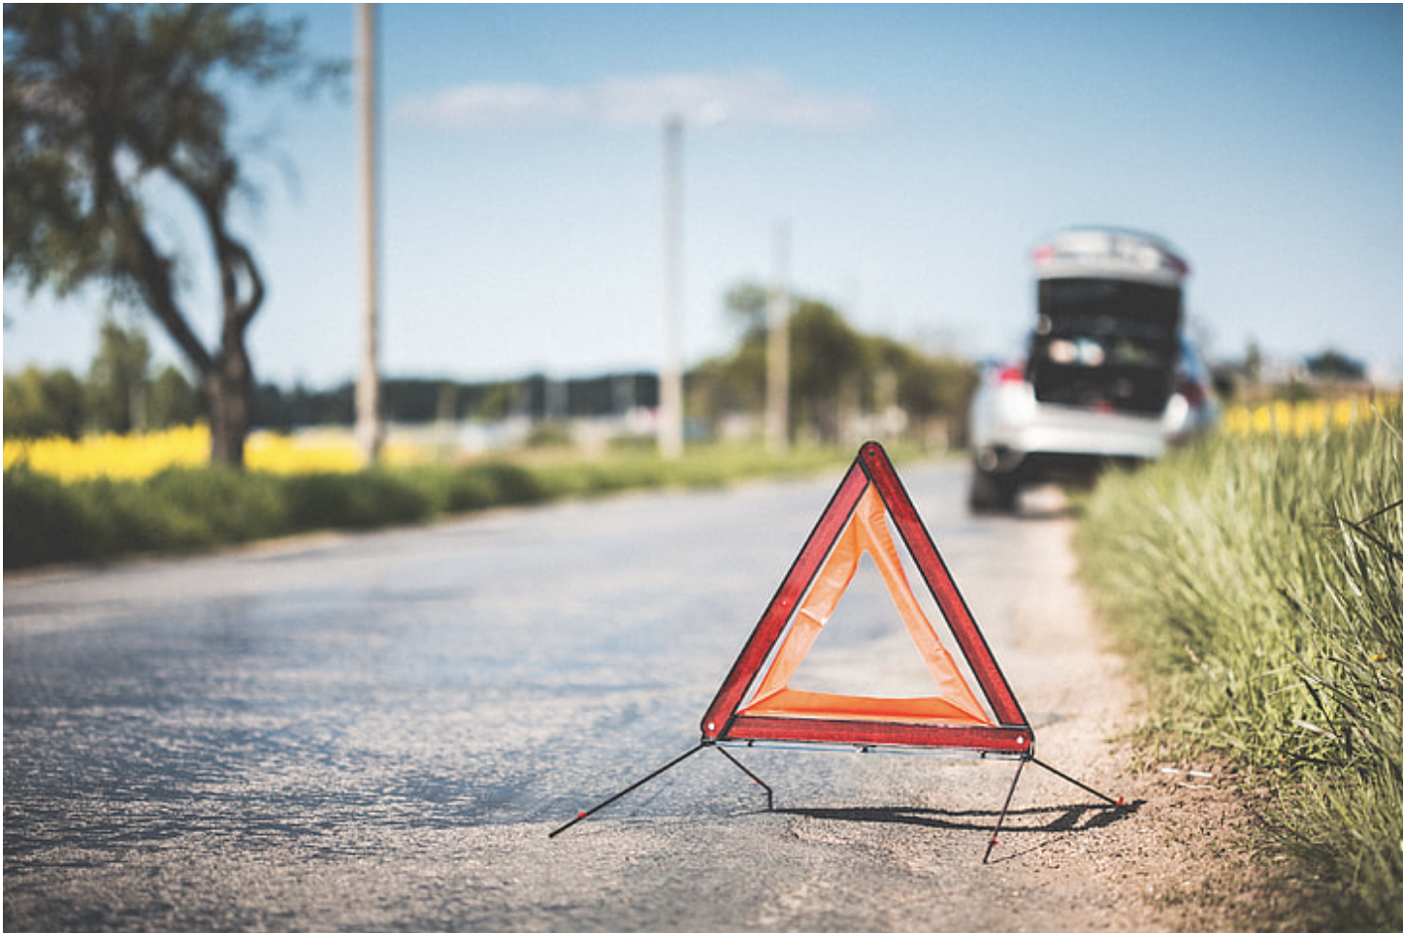


Predicting Severity of road accidents Elizabeth Kelley, Jack Wagner, Supriyo Ghosh, Tristan Freiberg
THE ERDŐS INSTITUTE
DATA SCIENCE BOOTCAMP, SPRING 2024
GitHub Repository

Slide 2
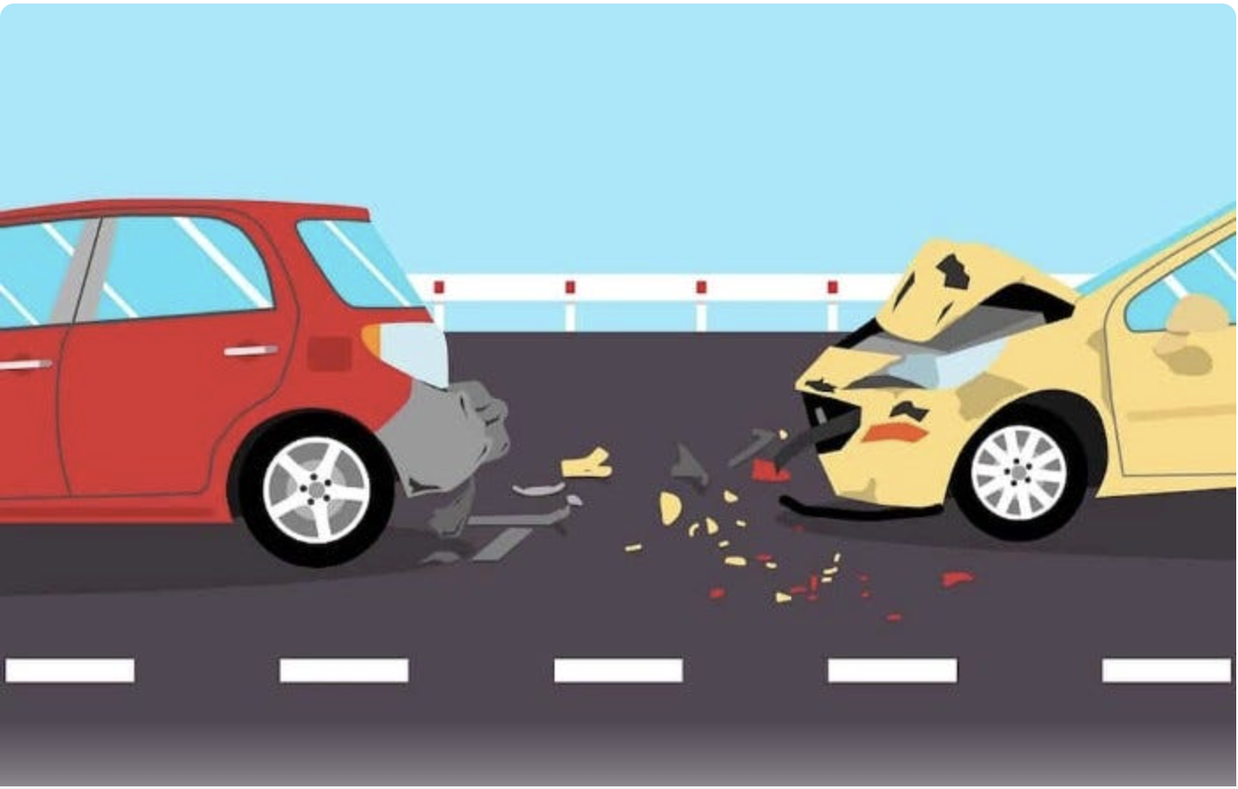
Introduction
Understanding and predicting traffic accident severity is crucial for improving emergency response protocols and urban planning strategies.
This project focused on analyzing data related to ~300,000 traffic accidents based on police reports filed in Montreal between 2011 and 2022.
The goal was to develop a model that could reliably predict the severity level of a traffic accident as belonging to one of three classes: material damage (no injuries), minor injuries, or serious/fatal injuries sustained by at least one person.
Providing 911 dispatchers or urban planners with predictive insights would facilitate better emergency response coordination, and infrastructure design that aligns with Vision Zero strategies, or generally reducing the frequency/severity of road accidents.

Slide 3
Data collection
We use the accident reports from QUEBEC AUTOMOBILE INSURANCE SOCIETY (SAAQ) for last 10 years.
Available features in the data can be grouped as: temporal (month, weekend/weekday, hour); environmental (e.g. weather, light conditions); road conditions and built-environment (speed limit, one-way versus two-way street, school zone/residential zone etc.); road users/vehicle (pedestrian, cyclist, motorcyclist, light truck, heavy vehicle); nature of the accident (single vehicle, collision with fixed object, animal, etc.).

Slide 4
Models Used
Models used: Baseline, Logistic, Random Forest, SVM, XGBoost
Final model: XGBoost with upsampling
 | Predicted
Actual | 0 | 1 | 2 | Total
0 | 29598 | 7862 | 2092 | 39552
1 | 2555 | 4289 | 2744 | 9588
2 | 62 | 88 | 277 | 427
Total | 32215 | 12239 | 5113 | 49567
 | F2 score: 0.689

Slide 5
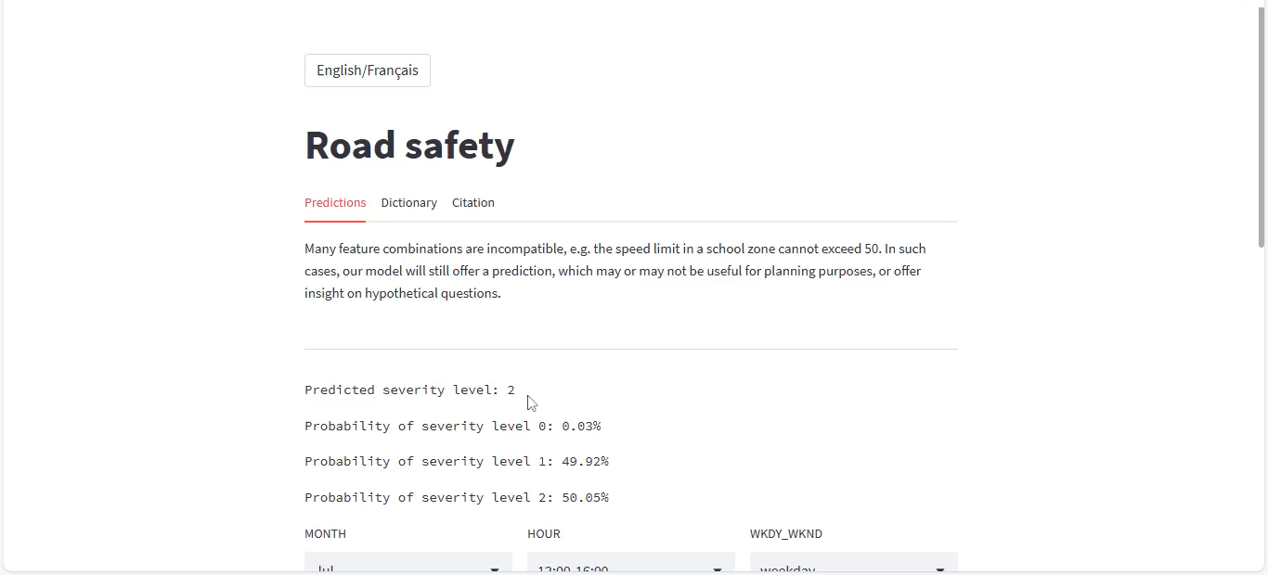
Streamlit application

Slide 6
Potential Future Directions
Test model on traffic data from different areas
Source traffic data with different variables to try to improve predictions
Create a tool for emergency vehicle dispatchers to allocate appropriate resources
Use model to make recommendations to city governments to improve areas with high accident severity

Slide 7
Acknowledgements
Our thanks to:
Dr. Adam Kawash, for his mentorship.
The Erdős Institute, for the opportunity and support!

